Slide 1

Transport Layer
The transport layer is responsible for delivery of a message from one process to another.
Services to application layer:
Get a message from an application program running on the source host and deliver it to the corresponding application
program on the destination host.

Slide 2

Figure 2.10 Transport layer

Slide 3

Figure 2.11 Reliable process-to-process delivery of a message

Slide 4
Transport Layer (TCP)
First establish a logical connection between transport layer at two host before transferring data.
Provide Reliable and orderly delivery of data
Provide
  Flow control: matching the sending data rate of the source host with the receiving data rate of destination
  Error control: guarantee that the segments arrive at the destination without error and resending the corrupted ones.
  Congestion control: reduce the loss of segments due to congestion in the network.

Slide 5
Example Header Information
Destination port
Sequence number
Checksum

Slide 6
UDP
Alternative to TCP is User Datagram Protocol
A connectionless protocol that transmits user datagrams without creating a logical connection.
  Not guaranteed delivery
  No preservation of sequence
  No protection against duplication
  Minimum overhead
  Adds port addressing to IP

Slide 7
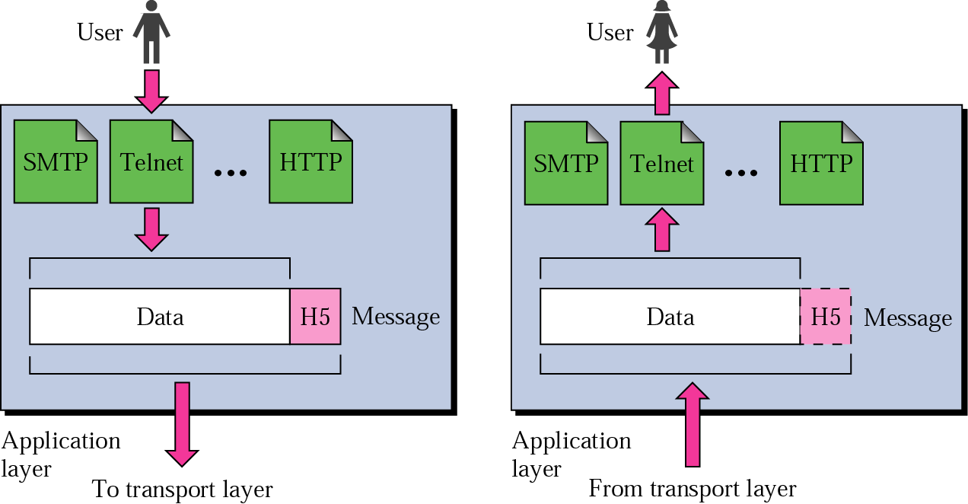
Application layer

Slide 8
Application Layer
The application layer is responsible for
providing services to the user. It is responsible for
process to process communication

Slide 9
Major duties
File transfer, access, and management
Mail services
Directory services
Web page access

Slide 10
Application Layer
Support for user applications
HTTP (Hypertext Transfer Protocol): access protocol for WWW
SMTP (Simple Mail Transfer Protocol): main protocol for e-mail
Domain Name Service (DNS): used by other protocols to find the network-layer address of a computer

Slide 11
Encapsulation and Decapsulation
The process of Adding a layer header to payload (or data) from the upper layer is called Encapsulation.
The process of removing a layer header from a received packet is called Decapsulation.
The header of each layer carries the protocol information of the respective layer.

Slide 12
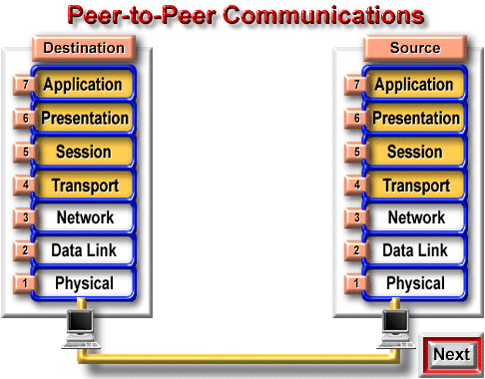
Encapsulation

Slide 13
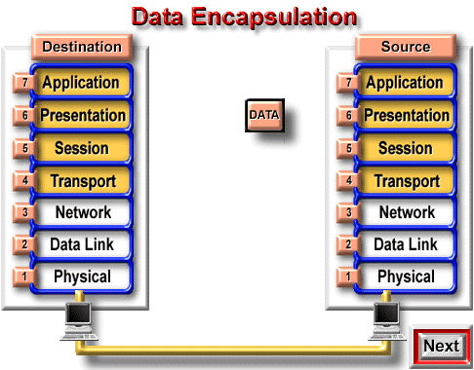
Application Send Data

Slide 14
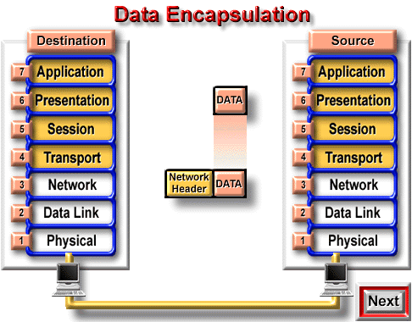
Network Layer Adds Header

Slide 15
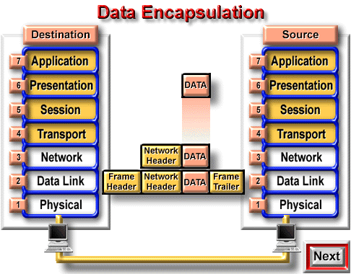
Data Link Layer Add its Header

Slide 16
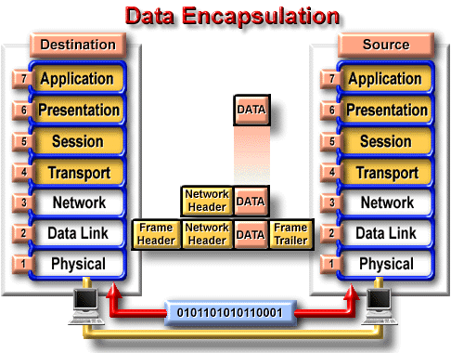
Physical Layer Sends in Bits

Slide 17
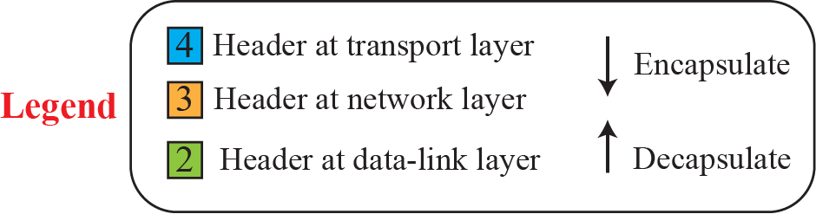
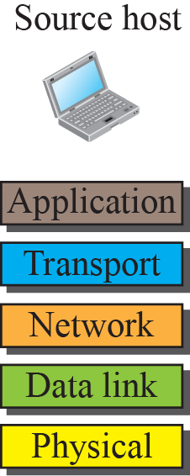
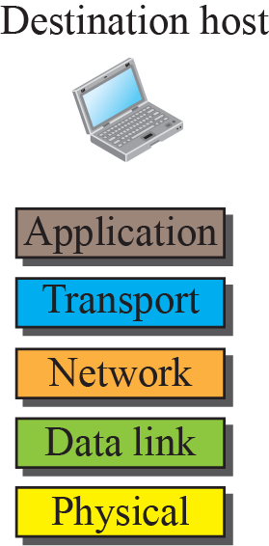

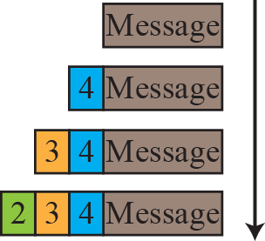
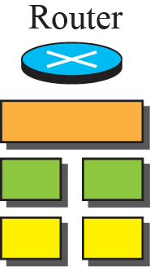
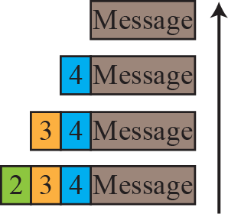
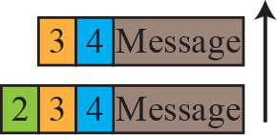
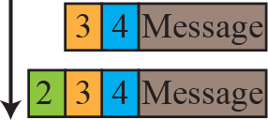
Encapsulation / Decapsulation
1.<number>
Notes:
1.#

Slide 18
2.2.5 ADDRESSING
Four levels of addresses are used in an internet employing the TCP/IP protocols: physical, logical, port, and specific.
Topics discussed in this section:
Physical Addresses
Logical Addresses
Port Addresses
Specific Addresses

Slide 19

Figure 2.17 Addresses in TCP/IP

Slide 20


Addressing in the TCP/IP protocol suite
1.<number>
Notes:
1.#

Slide 21

Figure 2.18 Relationship of layers and addresses in TCP/IP

Slide 22
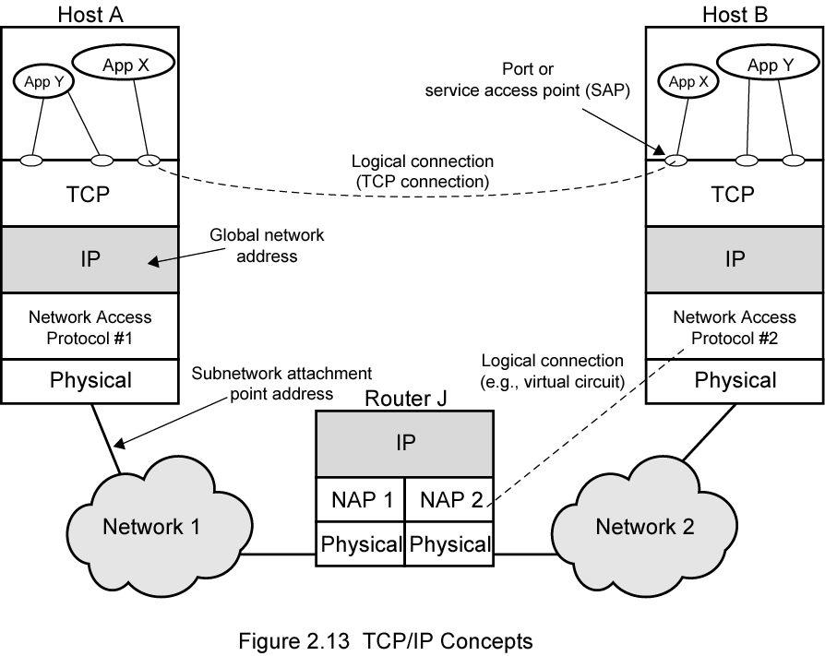
TCP/IP Concepts

Slide 23
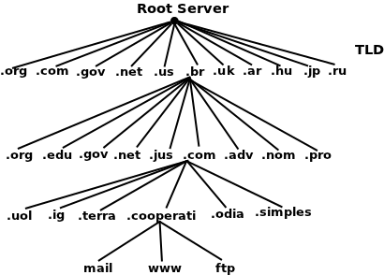
Specific address
Name
csdchung@saturn.yzu.edu.tw
www.cooperati.com.br
Personal id
Domain name
Host in domain

Slide 24
Port number
Port # is local in each machine to identify a process.
Each host has 64K ports for each transport protocol, TCP and UDP.
Well-known port | short-lived port
Reserved for each well-known service | Request on demand from kernel
 | Released when the process terminate

Slide 25
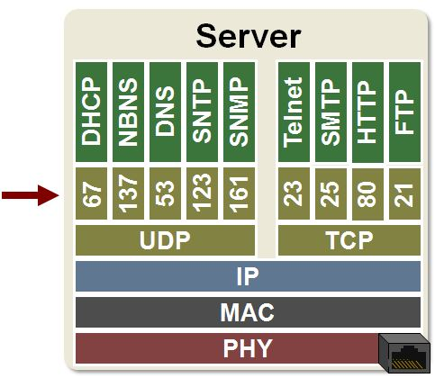
Well-known ports

Slide 26
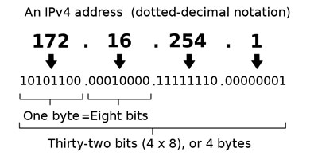
Logical address (IPv4)
Notation of IPv4 by dotted decimal

Slide 27
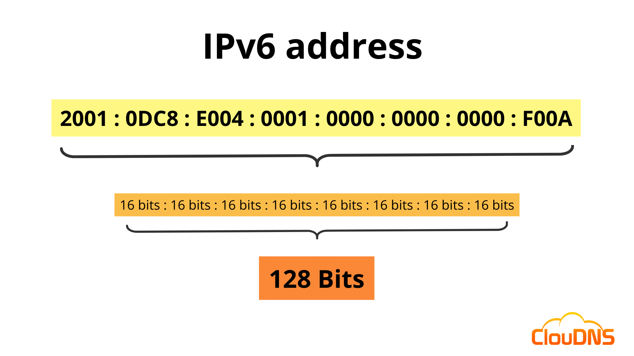
Logical address (IPv6)

Slide 28
Physical address
As we will see in Chapter 13, most local-area networks use a 48-bit (6-byte) physical address written as 12 hexadecimal digits; every byte (2 hexadecimal digits) is separated by a colon, as shown below:
07:01:02:01:2C:4B
A 6-byte (12 hexadecimal digits) physical address.

Slide 29

Note
The physical addresses will change from
hop to hop, but the logical addresses usually remain the same.

Slide 30

Example 2.4 Port addresses

Slide 31
Multiplexing and Demultiplexing
Multiplexing at the source and demultiplexing at the destination.
  Multiplexing: a protocol at a layer can encapsulate a packet from several next-higher layer protocols (one at a time);
  Demultiplexing: a protocol can decapsulate and deliver a packet to several next-higher layer protocols (one at a time).

Slide 32
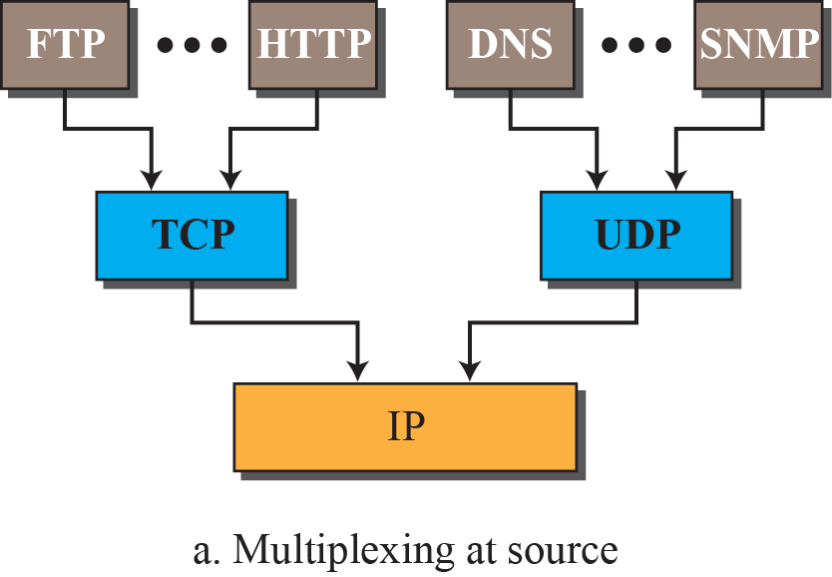
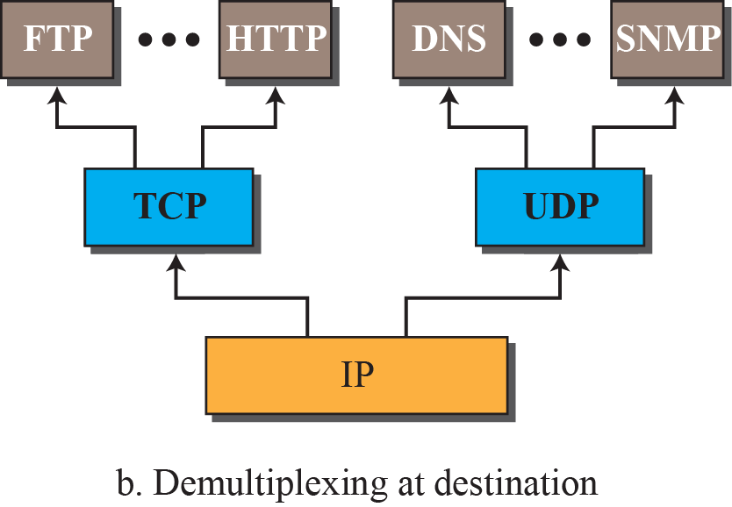
Figure 2.10: Multiplexing and demultiplexing
Port#
Protocol type
TCP or UDP
NetBios
Data link layer
1.<number>
Notes:
1.#

Slide 33
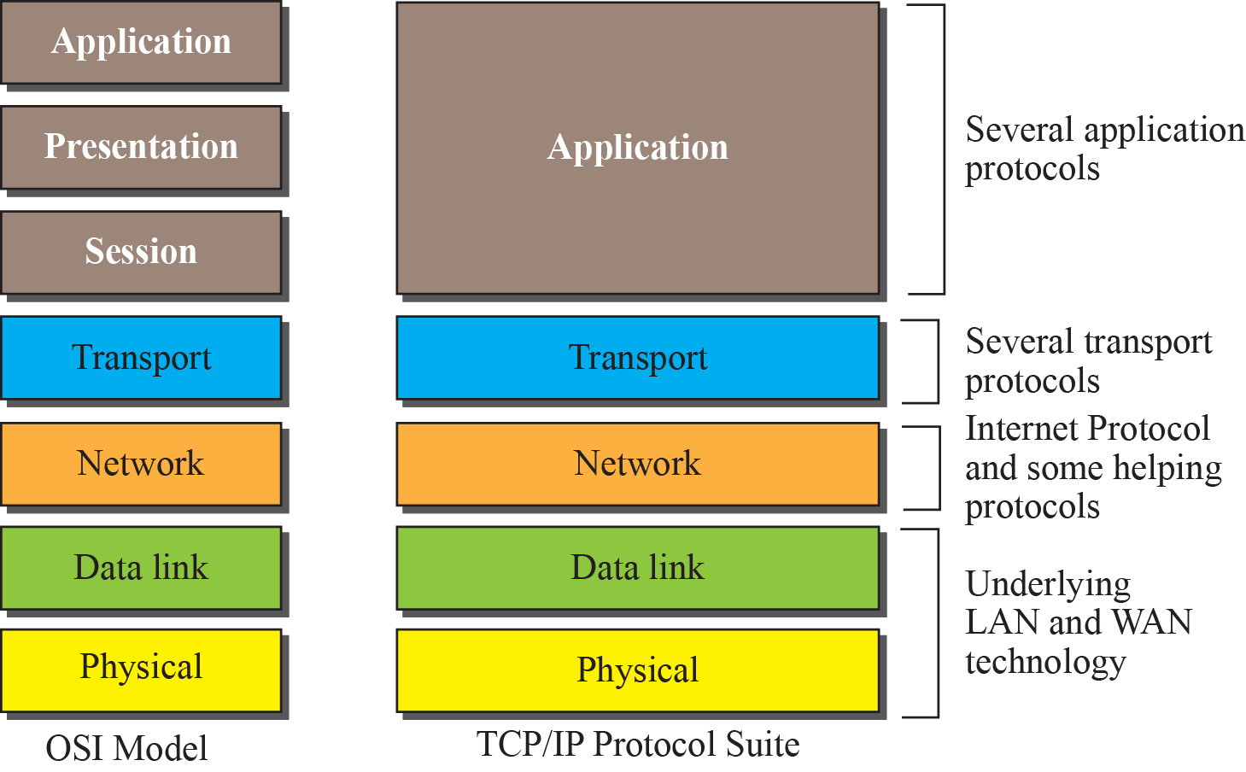
Figure 2.12: TCP/IP and OSI model
1.<number>
Notes:
1.#

Slide 34
OSI model
OSI (Open Systems Interconnection) model is an ISO standard that covers all aspects of network communication.
OSI model is not a protocol but a model for understanding and designing a network architecture that is flexible, robust, and interoperable.
OSI model consists of seven layers.

Slide 35

Figure 2.12 OSI Session layer

Slide 36
Note
The session layer is responsible for dialog
control and synchronization.
It establishes, maintains, and synchronizes the interaction among communicating systems.

Slide 37
Major duties
Dialog control
  Control processes to talk in either half-duplex or full-duplex
Synchronization
  Add check points, or synchronization points, to a stream data.

Slide 38

Figure 2.13 OSI Presentation layer
The presentation layer is concerned with the syntax and semantics of the information exchanged between two systems.

Slide 39
Note
The presentation layer is responsible for translation, compression, and encryption.

Slide 40
Major duties
Translation: translate between different encoding systems.
Encryption
Compression

Slide 41

Figure 2.15 Summary of layers

